Slide 1
MedTrack_DV
Hospital Operations & Patient Analytics Dashboard
Turning hospital data into decisions with four interactive Tableau dashboards
Shivam Rawat | Final Project Presentation | October 2026

Slide 2
Project Overview
The Problem
45,000
11
Hospital management needs one clear view of admissions, beds, patient movement, departments and resources, but the data sits across 19 separate tables.
admissions
departments
The Objective
2020-25
4
Build an end-to-end analytics solution: raw data to engineered KPIs to dashboards that answer key operational questions.
data span
dashboards
Source: Hospital HMIS Dataset (Kaggle), a relational hospital management system covering patients, billing, pharmacy and staff.

Slide 3
Technology Stack
1
2
3
Data Source
Data Processing
Data Storage
Kaggle HMIS dataset, 19 relational tables
Python and Jupyter Notebooks, 5-stage pipeline
CSV (raw and processed), Tableau .hyper extracts
4
5
6
Visualization
Automation
Docs & Versioning
Tableau: parameters, LOD calculations, context filters
Python scripts for data collection and KPI generation
Markdown documentation, GitHub

Slide 4
Core Features
4 dashboards, 4 business questions
6 engineered KPIs
1
Hospital Overview
Total Admissions
Occupancy Rate
How is the hospital performing?
2
Patient Flow
Average Length of Stay
Readmission Rate
How are patients moving?
3
Department Analytics
Bed Utilization Rate
Department Efficiency Score
Which departments need attention?
4
Resource Utilization
Department and Year selectors, navigation bar, Drug Shortage Watch with severity alerts
How well are beds, staff and drugs used?

Slide 5
Architecture / Data Pipeline
Kaggle HMIS
19 tables
›
Clean &
Normalize
›
Validate
›
ETL into
4 tables
›
KPI
Engineering
›
Tableau
4 dashboards
Four analytical tables, each built at the grain its dashboard needs
45,000
153,269
24,244
13,549
hospital_overview
patient_flow
department_analytics
resource_utilization
1 row per admission
1 row per flow event
1 row per department per day
department + date + resource
Tableau model: two linked groups (overview + flow, department + resource) using extracts for fast performance.

Slide 6
Challenges
1
Movement data
2
Bed occupancy
3
Mixed grains
No patient movement log in the source data
No daily history, only a current snapshot
Admission, event, daily and snapshot tables hard to combine
4
Readmissions
5
Filter sync
6
Drug names
Late admissions lacked a full 30-day follow-up window
Filters out of sync across two Tableau data groups
Duplicate names across drug IDs distorted shortages

Slide 7
Solutions Implemented
1
Event log
2
Modeled census
3
Purpose-built tables
Built from Admission, Discharge and Diagnostic Test events
Running total of admissions minus discharges per department
Right grain per dashboard, with a full calendar spine
4
Adjusted rate
5
Shared parameters
6
Drug Label
Readmissions counted only with a full 30-day window
Department and Year selectors sync all dashboards
Name plus ID gives each drug an accurate count

Slide 8
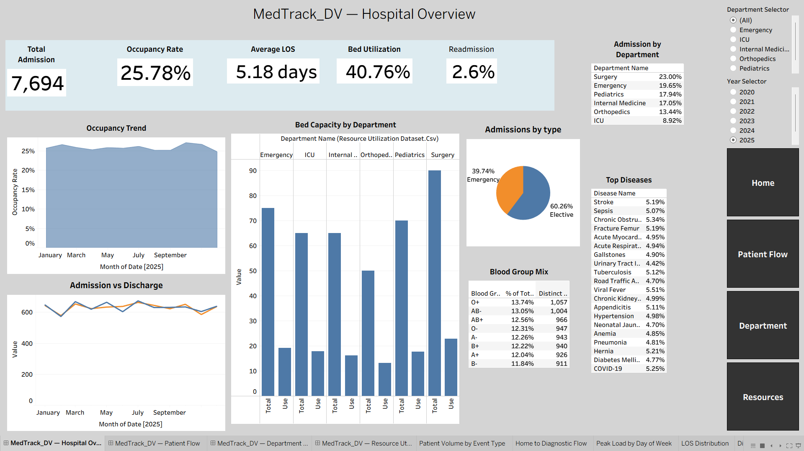
Hospital Overview
Volume at a glance
Five KPI tiles with trend, capacity and admission mix
Admission mix
60.3% elective vs 39.7% emergency
Demand drivers
Top diseases and blood group mix guide planning

Slide 9
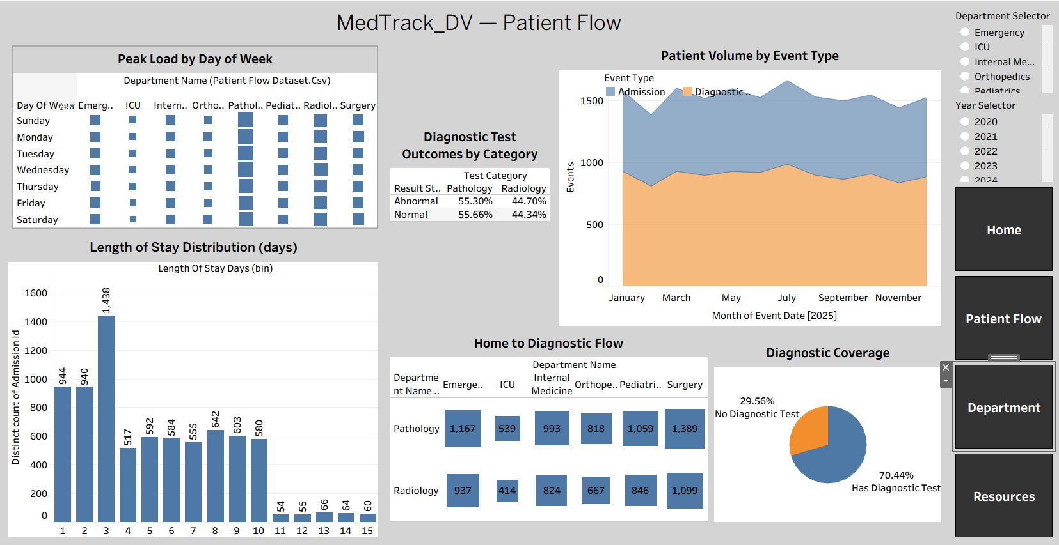
Patient Flow
Daily rhythm
Admissions, discharges and tests on one view
Diagnostic coverage
70.4% of admissions reach a diagnostic test
Stay profile
Most stays last 1 to 3 days

Slide 10
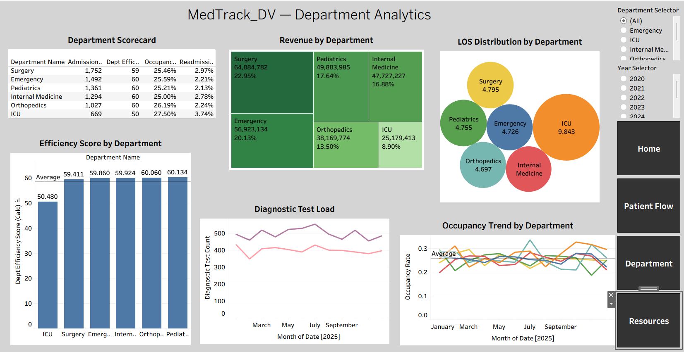
Department Analytics
Side-by-side scorecard
Admissions, occupancy, LOS, readmissions, efficiency
ICU stands out
Lowest efficiency score at 50.5
Revenue view
Surgery leads at 22.95% of revenue

Slide 11
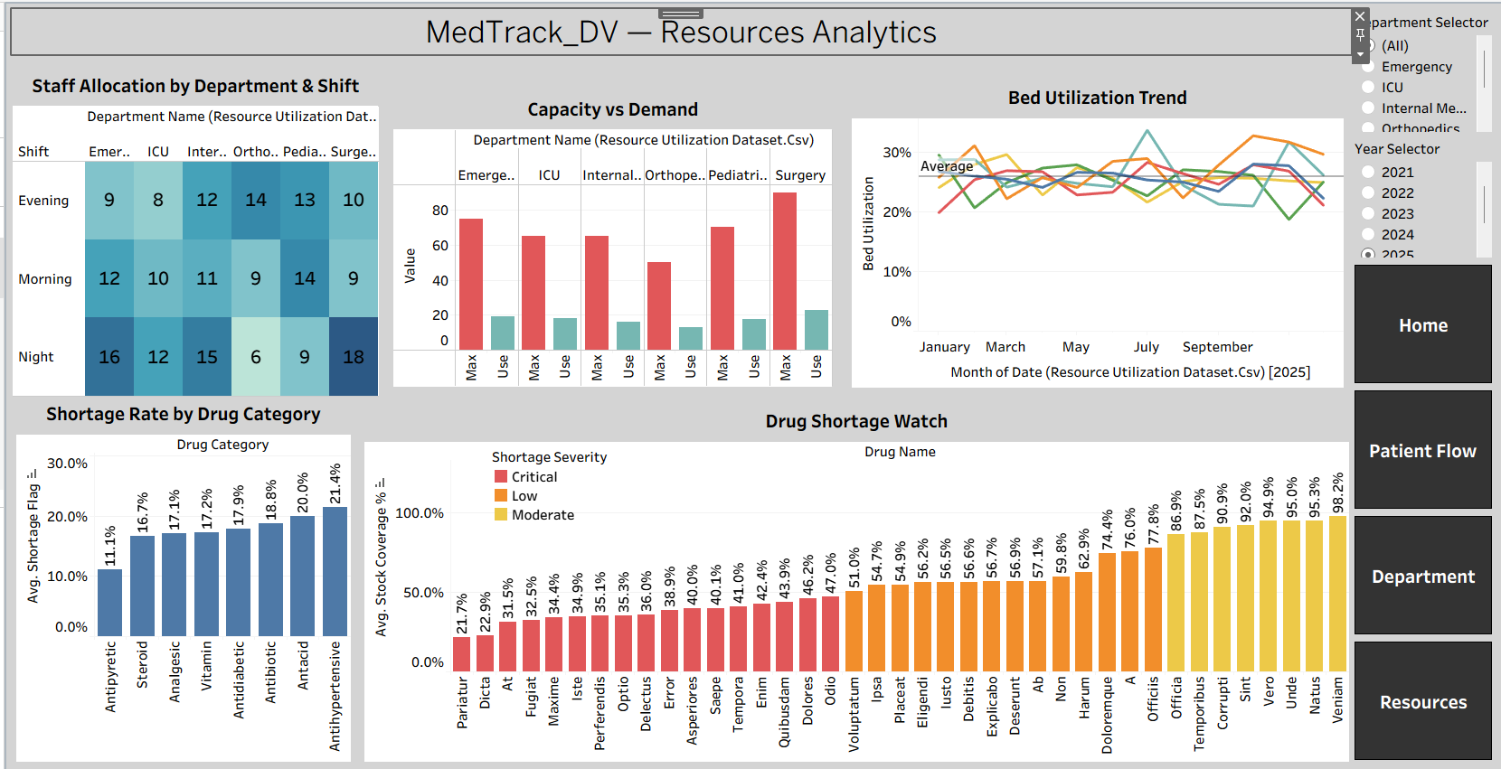
Resource Utilization
Bed capacity
Max vs average use for every department
Staffing
Allocation by department and shift
Drug Shortage Watch
Severity-coded stock alerts by drug

Slide 12
Outcomes and Key Insights
45,000
5.16 days
25.36%
2.52%
Total admissions
Average LOS
Occupancy
Readmission rate
ICU is the standout: highest occupancy (28.15%) but lowest efficiency, with a 10-day average stay vs about 4.7 elsewhere
Pediatrics leads efficiency (60.13); Orthopedics has the lowest readmissions (2.17%)
Radiology and Pathology traffic is now visible alongside admissions
44 of 250 drugs sit below reorder level, making alerts actionable

Slide 13
Learnings and Future Scope
Learnings
Future Scope
Designing data at the right grain for each purpose
Validating every number from two independent sources
Building parameter-driven Tableau dashboards
Real-time feeds and a live connection
Predictive models for readmission and bed demand
Multi-hospital benchmarking
Alerts for drug shortages and high occupancy

Slide 14
Thank You
Questions & Discussion
Live Tableau dashboard
GitHub repository

